Slide 1
Exploratory analysis of differences between modeled and observed spatial distributions of snow water equivalent in the Tuolumne River area Nicoleta Cristea and Claire beveridge CEE, University of Washington, Seattle
#hydrohack

Slide 2
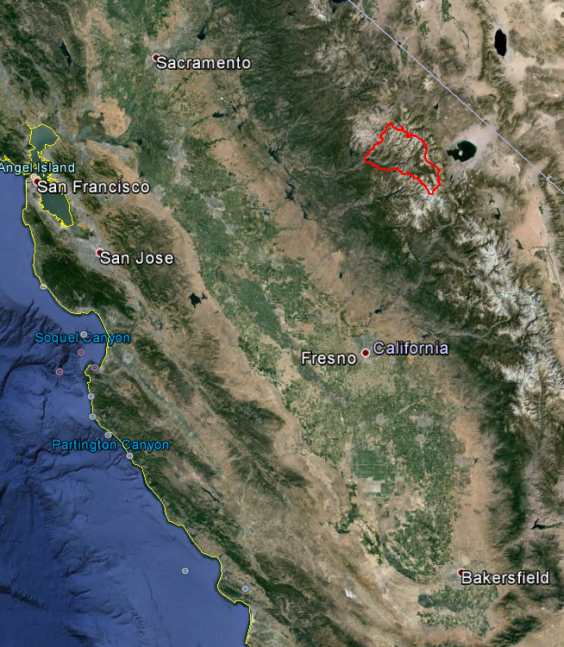
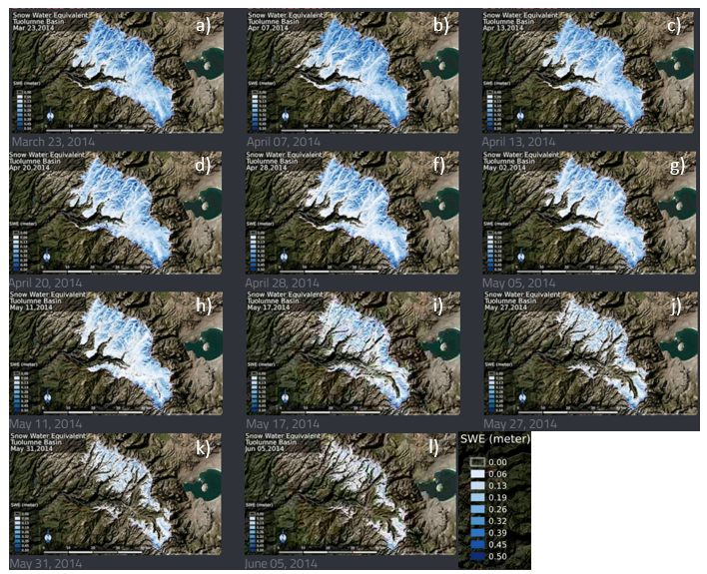

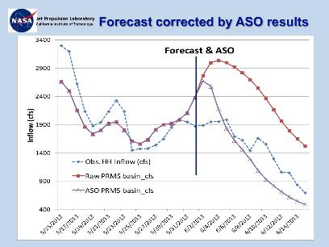
Tuolumne River basin & ASO SWE in 2014
~3000m elevation range
~1181 km²
Notes:
We can observe snow cover areas from space, Some of the more popular snow products are MODIS – and Landsat
MODIS – SCA and fSCA
Landsat – SCA
MODIS- high temporal but coarse spatial resolution
Landsat – high spatial resolution but low temporal
Through downscaling - Can get high temporal and spatial resolution

Slide 3
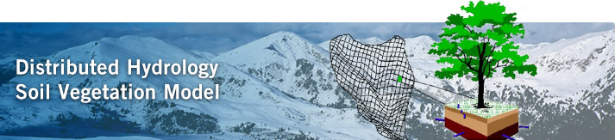
MODEL, DHSVM
Fully distributed land surface scheme hydrology
90m resolution
SWE = state variable
WANT THE MODEL TO REPRESENT THE OBSERVED SWE PATTERNS

Slide 4
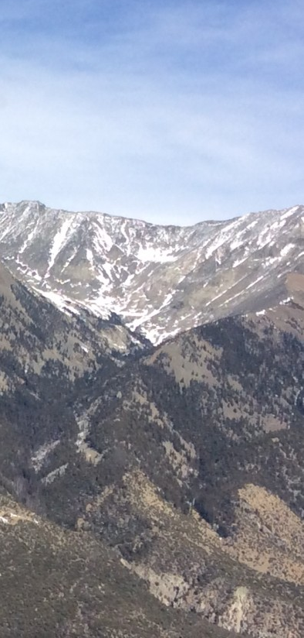
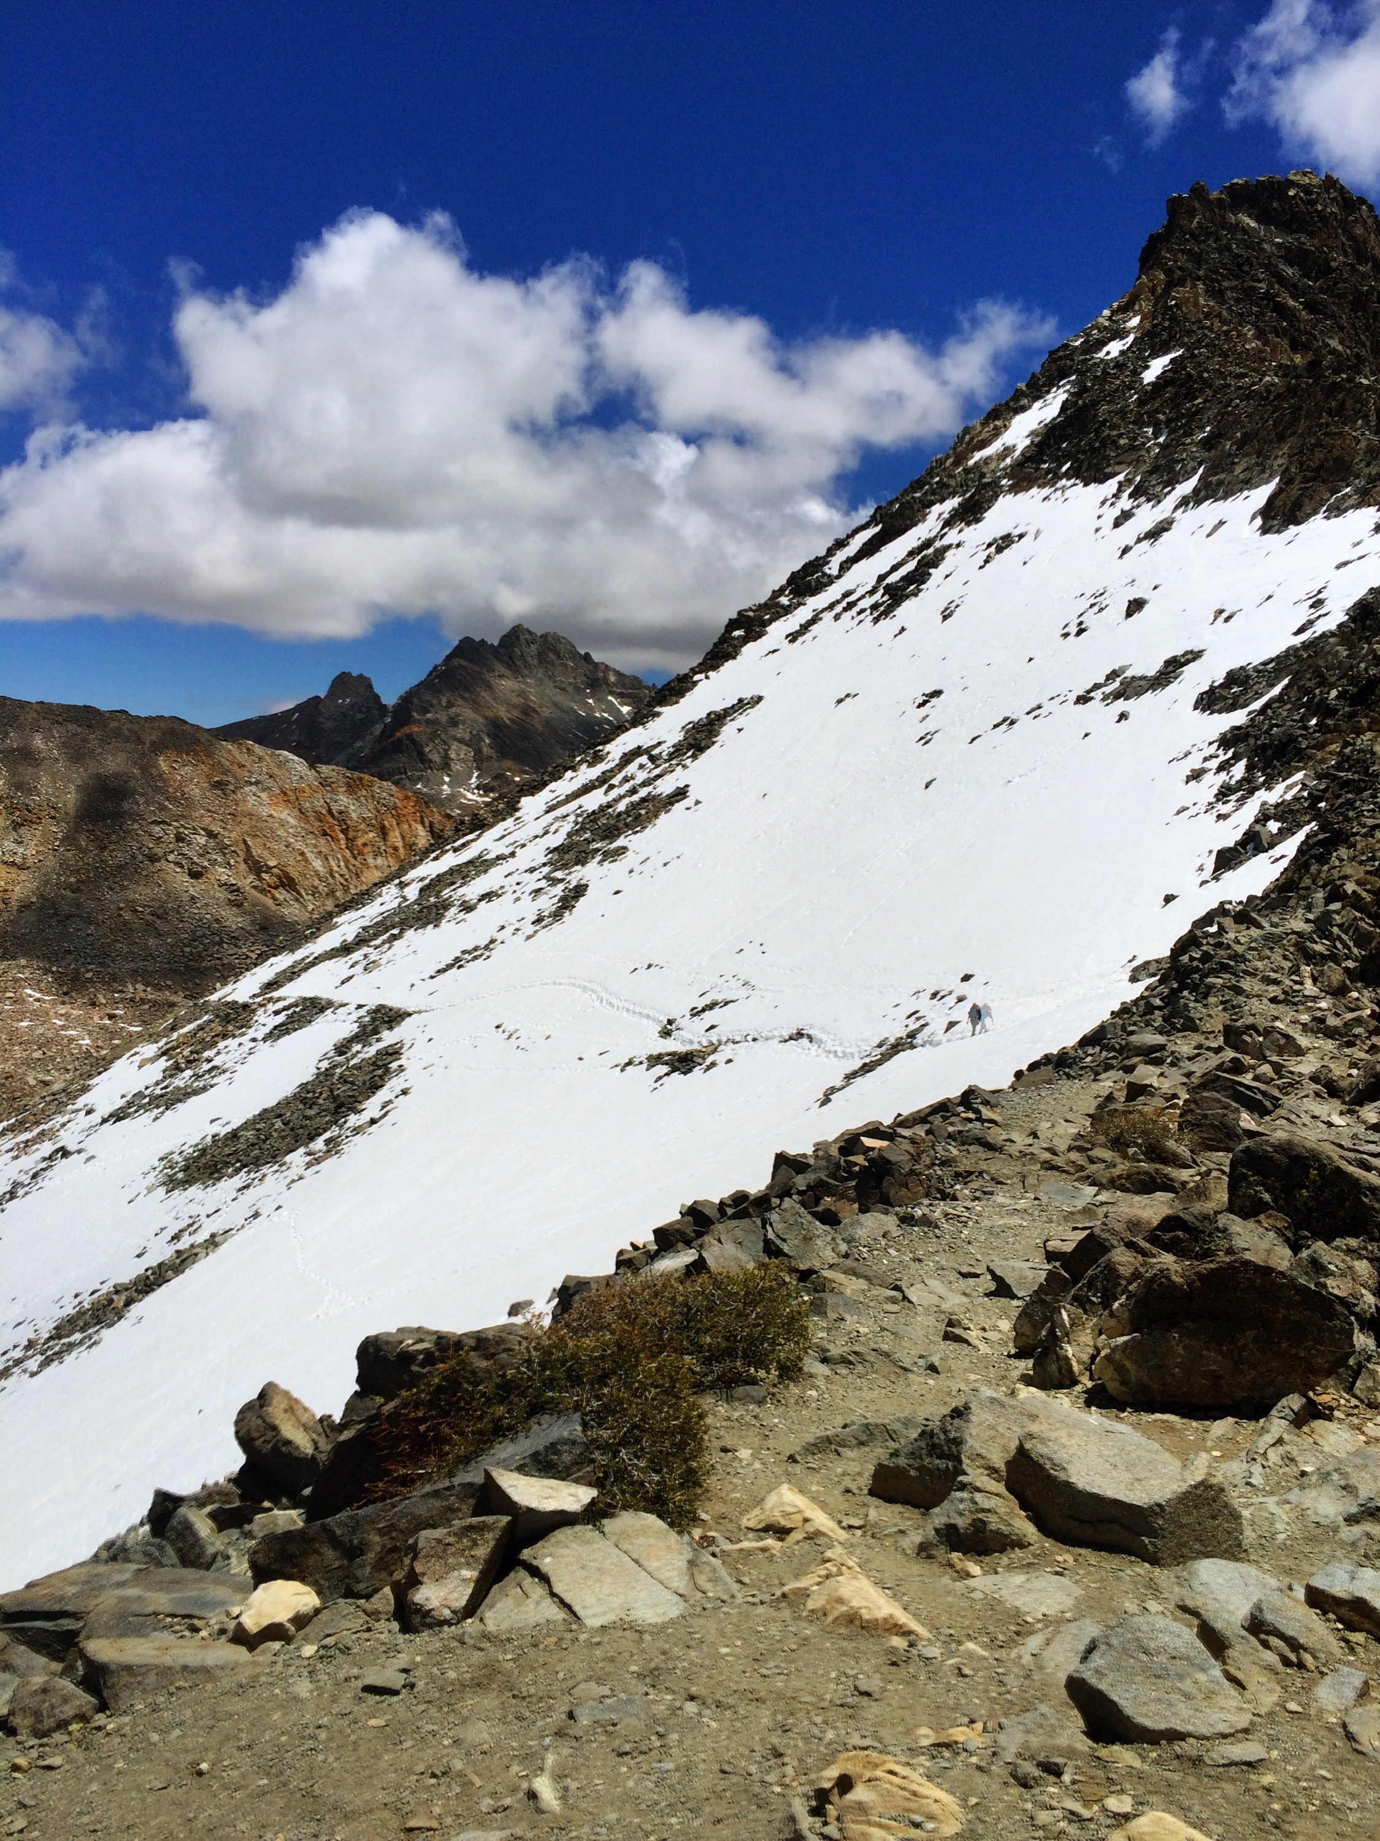
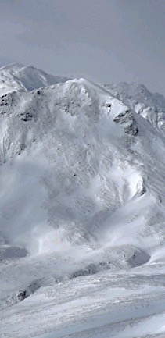
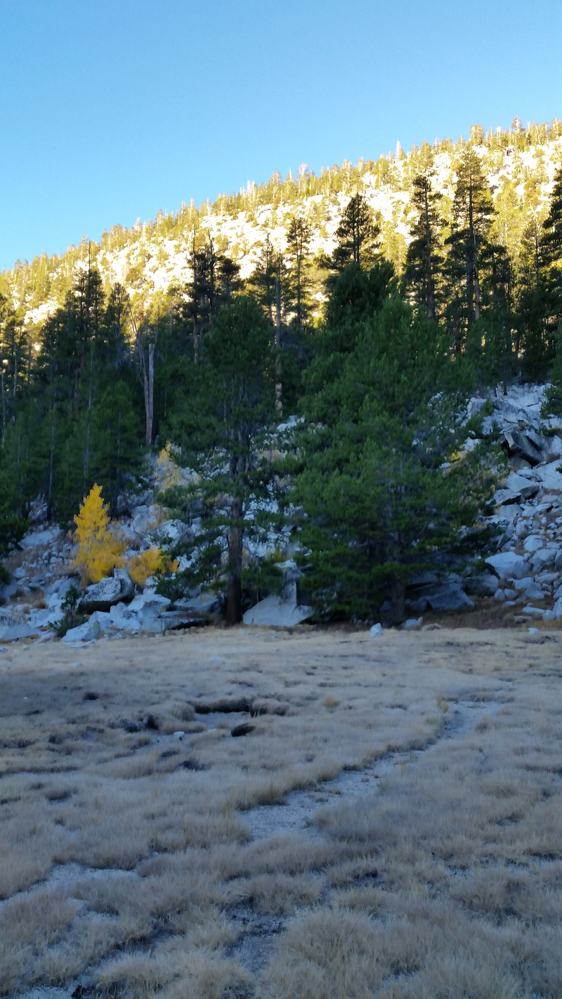
Controls of snow distribution across complex terrain
Elevation, terrain, wind, vegetation
Both accumulation and ablation processes
Notes:
Differential ablation, with earlier and more frequent ablation at lower elevations
Terrain features slope and aspect control the amount of insolation
High wind speeds and orographic effects control snow deposition
Vegetation controls both accumulation and ablation processes

Slide 5
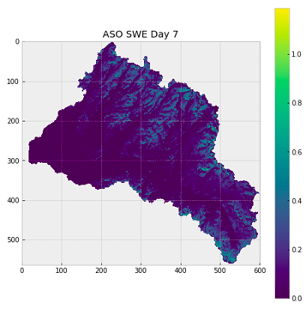
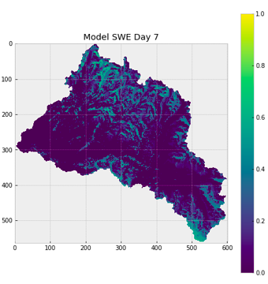
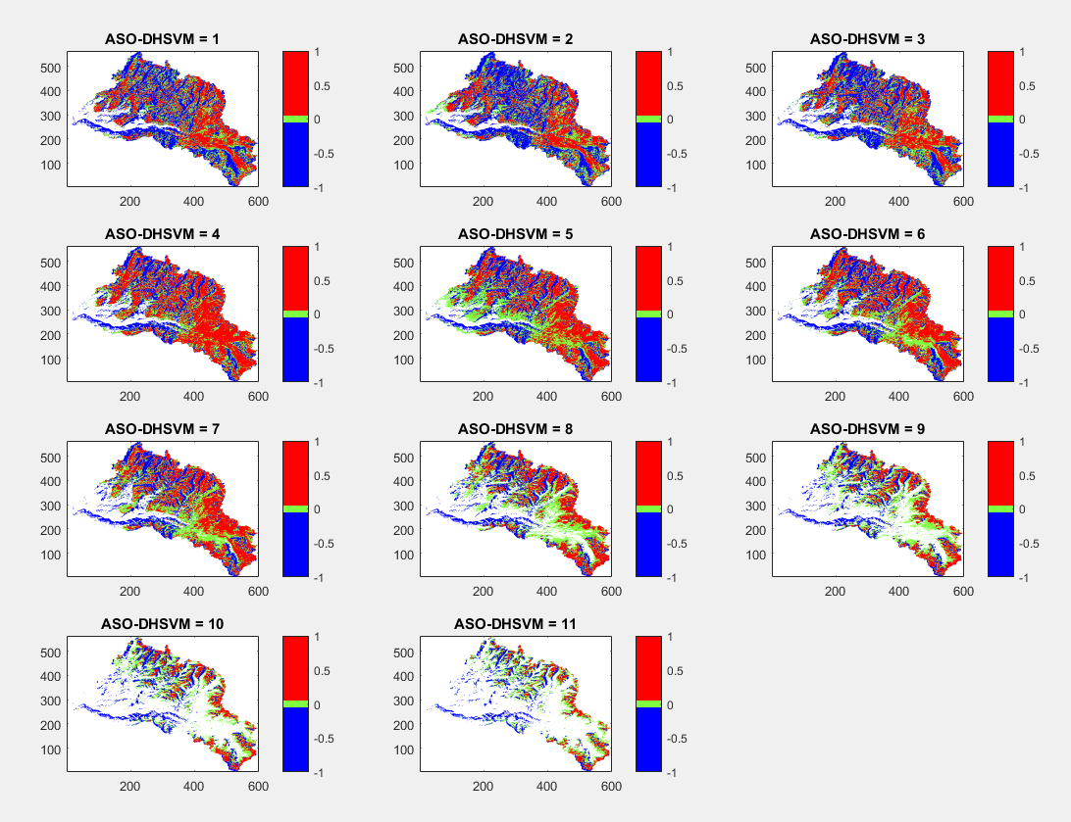
SNOW Water equivalent, SWE, MAY 11 2014
ASO
MODEL
Difference = ASO - MODEL
More ASO
About the same
More model

Slide 6
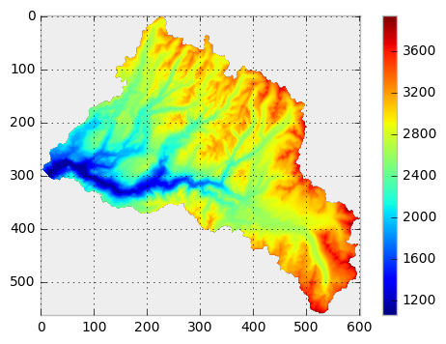
GEOHACK WEEK 2017
Derived slope and aspect using gdal libraries
Used mask functionality from numpy

Slide 7
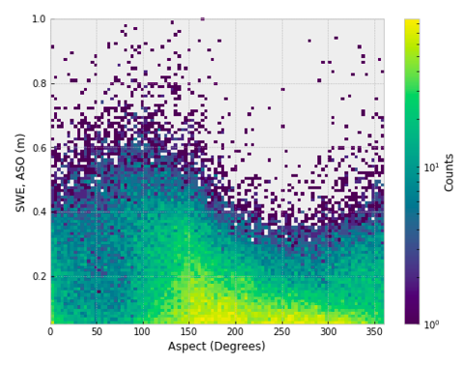
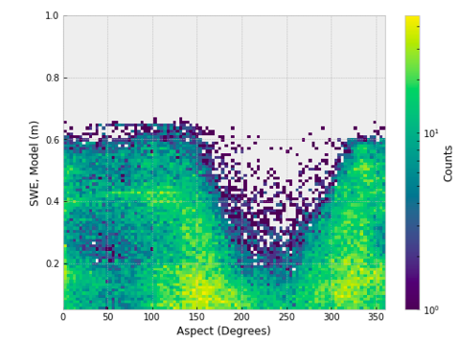
SWE, aspect Distribution
SWE, ASO
SWE, MODEL
2D histograms

Slide 8
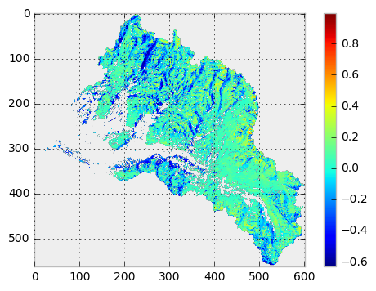
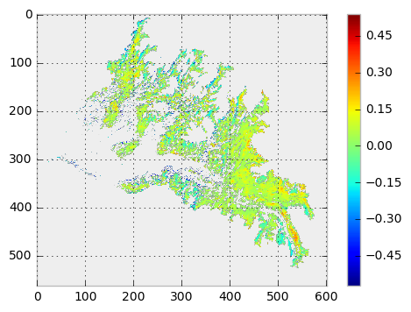
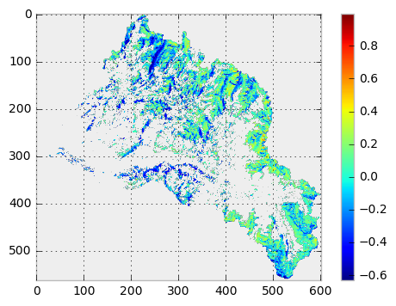
Delta = ASO - model
All areas
Forested
Exposed
create_mask (elevation, slope, aspect, veg_map)

Slide 9
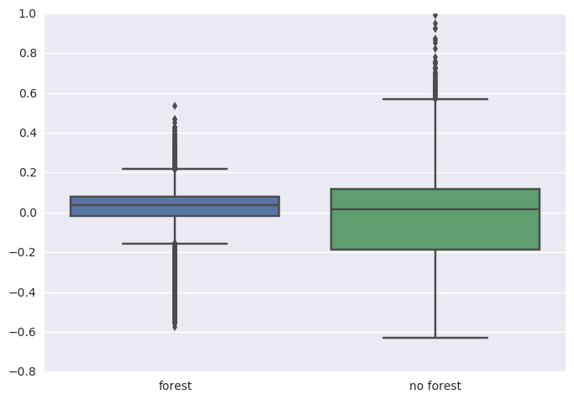
Delta = ASO - model
More ASO
More model
Forest
Exposed

Slide 10
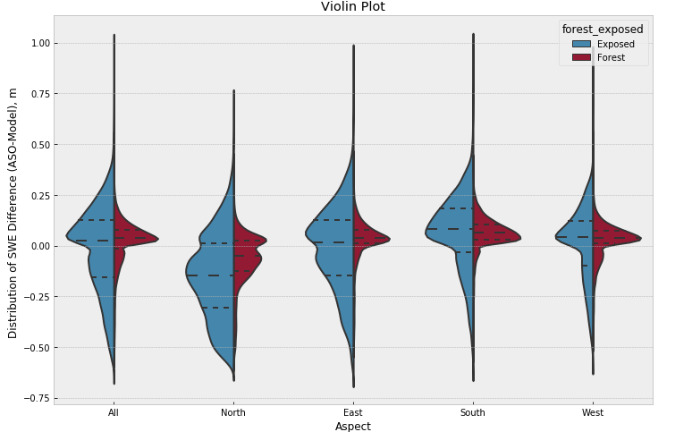
VIOLIN PLOT, ASPECT Scale= Count, Inner= Quartile, pandas dataframes, seaborn
ALL ASPECTS
NORTH
SOUTH
EAST
WEST
More ASO
More model

Slide 11
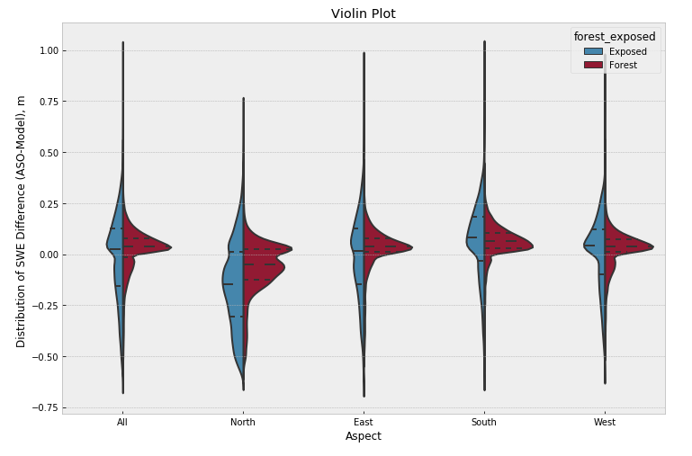
VIOLIN PLOT, ASPECT Scale= AREA, Inner= Quartile
ALL ASPECTS
NORTH
SOUTH
EAST
WEST
More ASO
More model

Slide 12
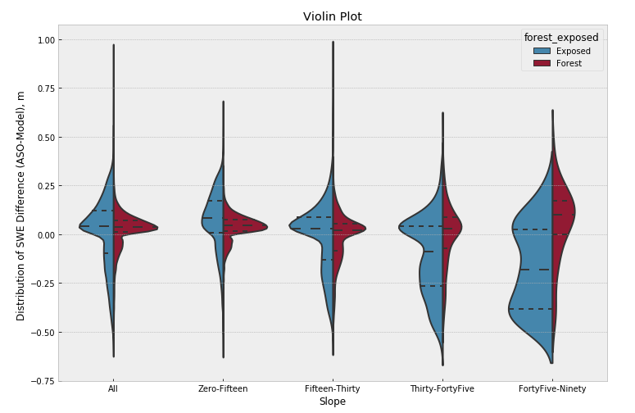
VIOLIN PLOT, SLOPE Scale= count, Inner= Quartile
ALL SLOPES
15-30
0-15
30-45
>45
More ASO
More model

Slide 14

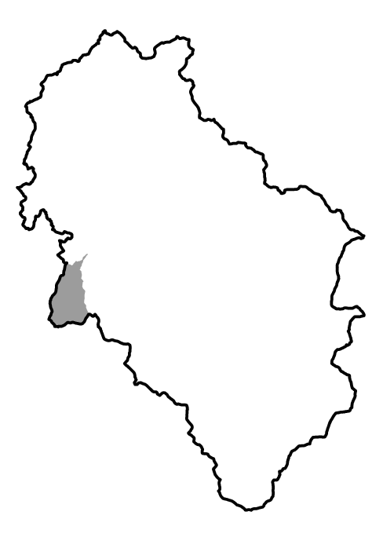
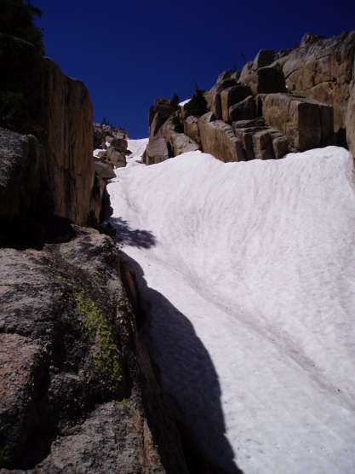
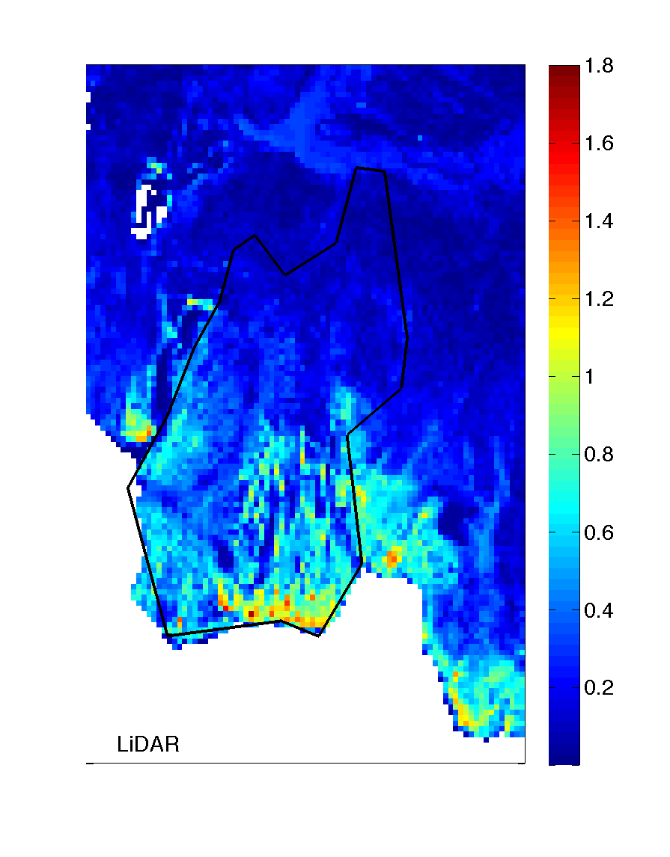
Accumulation
Less snow on
the steep
leeward slopes
Wind direction
More snow
in concavities
Orographic effects
Direction of storms
Topography
Notes:
Accumulation is controlled by orographic effects and direction
of storms and topographic features
Huge variability: snow piles in fissures & in cirques

